Slide 1



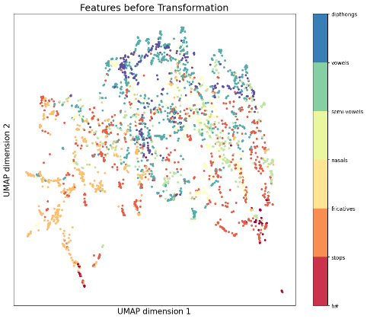
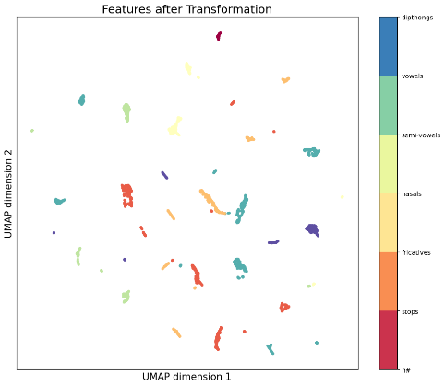
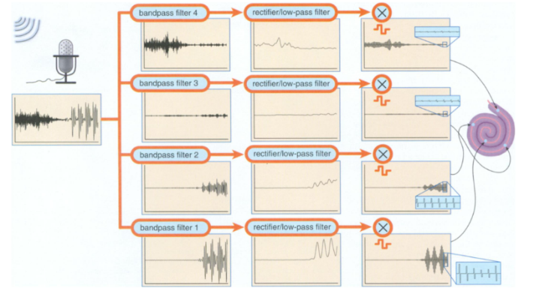
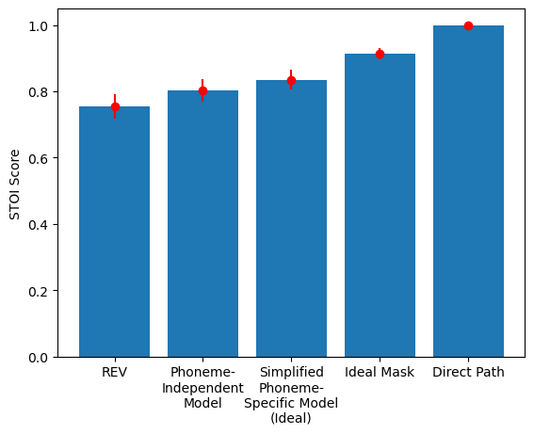
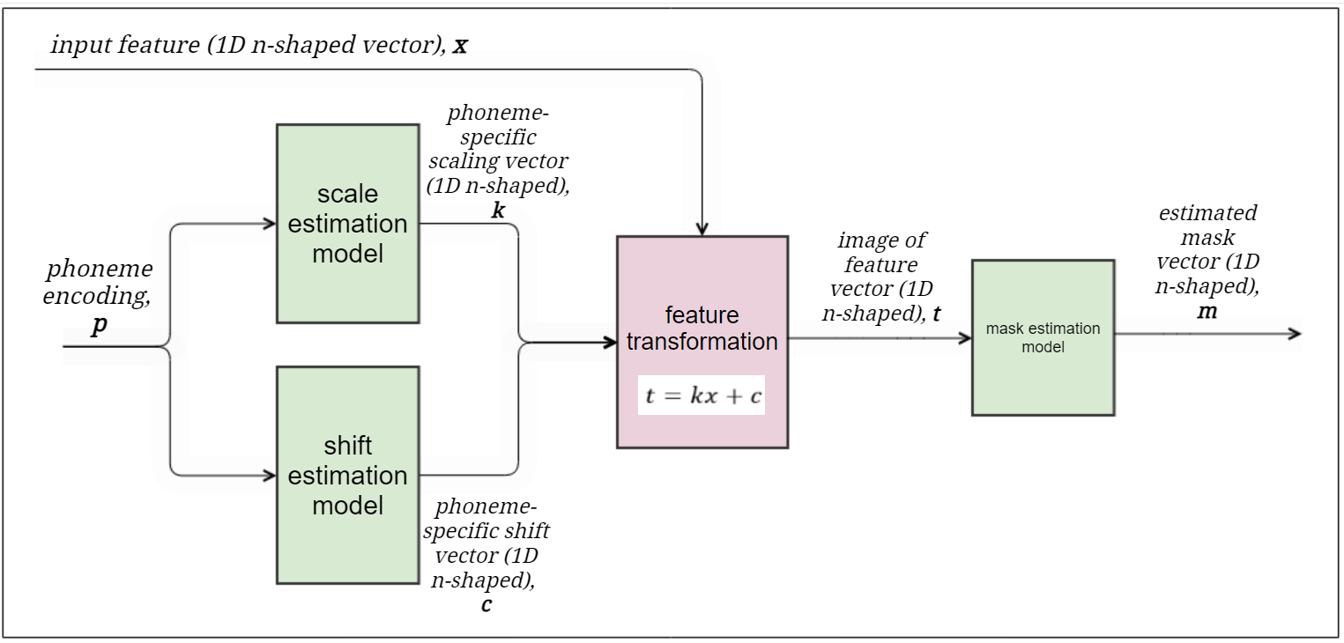
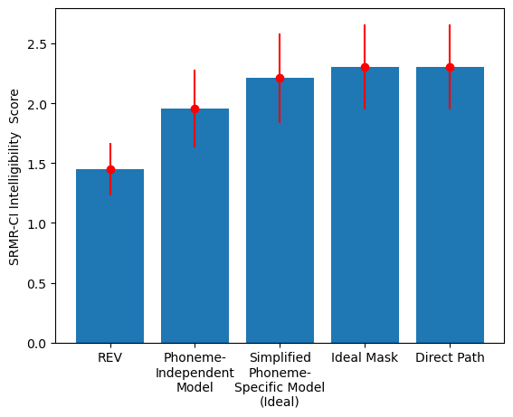
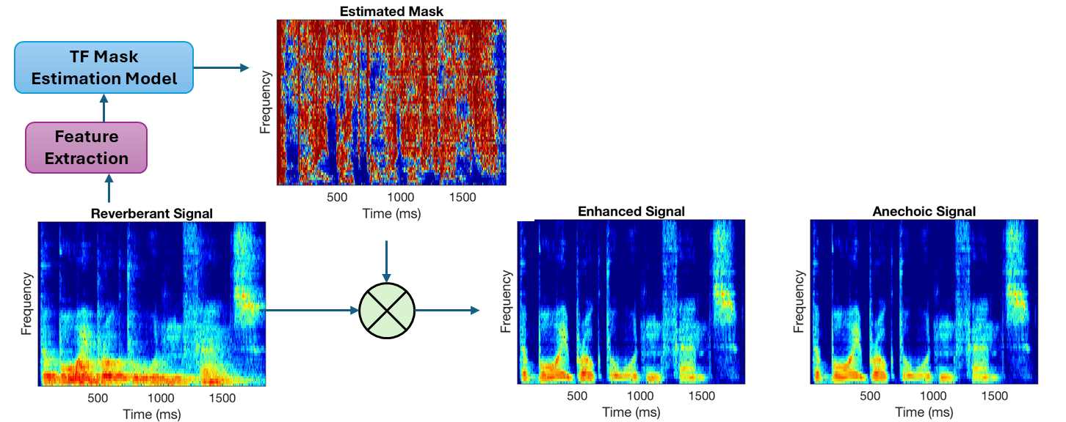
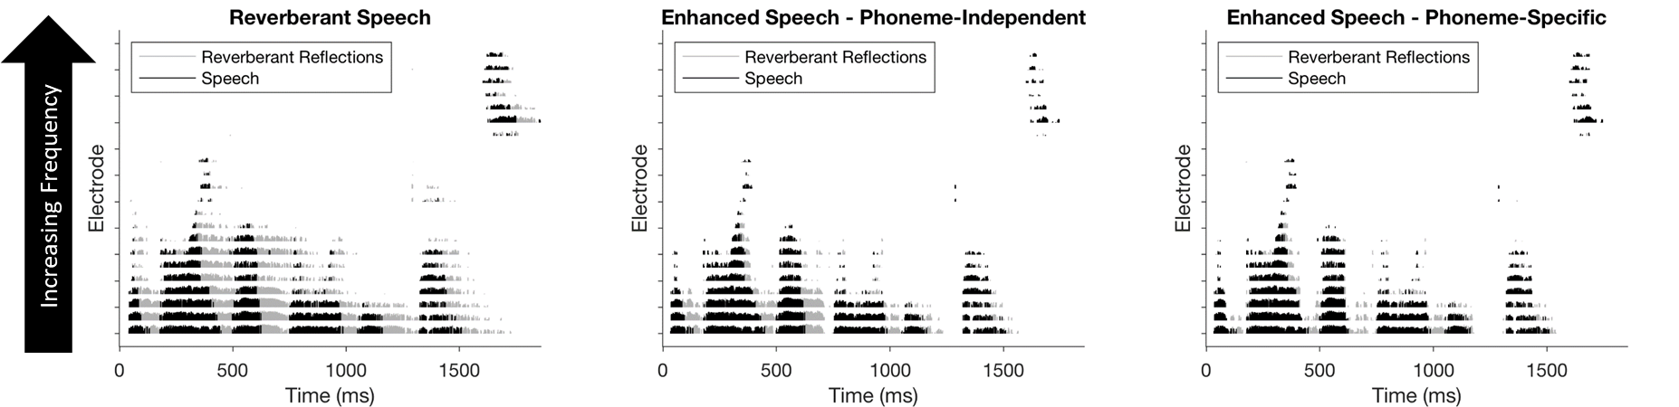
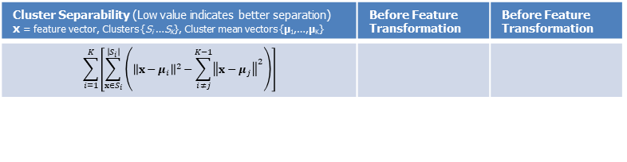
Mitigating Reverberation in Cochlear Implant Stimulus Patterns Using Phoneme-based Transformations and Time-Frequency Mask Estimation Mezisashe Ojuba¹; Boyla Mainsah, PhD² 1 Department of Electrical Engineering and Computer Science, Howard University 2 Department of Electrical and Computer Engineering (ECE), Duke University
Introduction
Objectives
Results: Feature Clusters
A cochlear implant (CI) is an electronic device that restores hearing to Deaf/Hard-of-Hearing people
Reduce complexity of phoneme-based mask estimation model to facilitate real-time implementation in Cis
Assess impact of simplified phoneme-specific mask estimation on reverberant speech enhancement via signal content and objective speech intelligibility measures
The CI processes sound picked up by a microphone placed outside the ear into electrical pulse amplitudes that are transmitted to electrodes implanted in the cochlea
The electrical stimuli is interpreted as sound sensation by the brain.
Phoneme-based Mask Estimation
Input features are expected to cluster according to phonemes
Prior approach: “Mixture of experts” with phoneme classification probabilities used to select a phoneme-specific mask estimation model
Current approach: Information about phoneme content provided to a single mask estimation model via phoneme-specific feature transformation, illustrated in Figure 4.
Figure 4: Illustration of Effect of Phoneme-specific Transformation on a subset of randomly chosen features (N = 2000). Dim. reduction using UMAP [11]. Phonemes grouped by manner of articulation [10] for visualization purposes.
Figure 1: Auditory Processing Pipeline of Cochlear Implant [1].
Cluster Separability (Low value indicates better separation) x = feature vector, Clusters {S_{i} …S_{K}}, Cluster mean vectors {µ₁,…,µ_{K}} | Before Feature Transformation | Before Feature Transformation
$$\sum_{i=1}^{K}{\left[\sum_{x∈S_{i}}^{\left|S_{i}\right|}{\left({\left\|x−μ_{i}\right\|}^{2}−\sum_{i≠j}^{K−1}{{\left\|x−μ_{j}\right\|}^{2}}\right)}\right]}$$
Motivation
Results: Speech Enhancement
CIs do not convey all the complexities of real-world sound and cochlea damage limits information transmission with electrical stimulation.
CI users struggle with sound perception in noisy and reverberant environments, with studies showing reduction of speech intelligibility [2] and reduction of sound localization ability [3].
Goal: Reduce signal distortions in noisy and reverberant speech to improve speech intelligibility in CI users.
Short Time Objective Intelligibility (STOI) [12].
Reverberant Speech Enhancement
Speech-to-reverberation Modulation Energy Ratio for Cochlear Implants (SRMR-CI) [7].
Time-Frequency (TF) masking is a methodology used to reduce signal distortions in reverberant conditions by applying a matrix of gain values to a time-frequency decomposed signal [4], Figure 2.
Figure 5: Mean and Standard Deviation of Objective Speech Intelligibility Measures. Conditions include reverberant speech (REV), reverberant speech enhanced with estimated and ideal time-frequency masks and direct path speech.
Figure 4: Proposed Pipeline for Simplified Phoneme-based Mask Estimation with Phoneme-Specific Feature Transformation
Discussion
Methods
Improved speech enhancement with ideal phoneme classification shows potential to simplify phoneme-based mask estimation with feature transformation
Future work will investigate mitigating reverberation in CIs with phoneme-specific mask estimation based on estimated phoneme probabilities to model
Features
Extracted from cochlear implant processing pipeline [13]
Feature transformation
Phoneme-specific scale and shift transformations
Idea scenario where the phoneme label is known
Multi-layer perceptron networks for shift and scale parameter prediction
Mask estimation model
Long short-term memory (LSTM) network
Phoneme-specific feature transformation variant initialized with phoneme-independent mask estimation model from [13]
Figure 2: Illustration of Enhancement of Cochlear Implant Processed Speech with Time-frequency Mask Estimation.
Chu et al., 2022 [4] developed TF mask estimation models for each phoneme which shows general increase in speech intelligibility over a singular phoneme-independent mask estimation model, Figure 3.
References
[1] Dorman, M. F., & Wilson, B. S. (2004). The Design and Function of Cochlear Implants: Fusing medicine, neural science and engineering, these devices transform human speech into an electrical code that deafened ears can understand. American Scientist, 92(5), 436–445.
[2] Badajoz-Davila J, Buchholz JM, Van-Hoesel R. Effect of noise and reverberation on speech intelligibility for cochlear implant recipients in realistic sound environments. J Acoust Soc Am. 2020 May;147(5):3538.
[3] Kerber, S., & Seeber, B. U. (2013). Localization in reverberation with cochlear implants: predicting performance from basic psychophysical measures. Journal of the Association for Research in Otolaryngology : JARO, 14(3), 379–392.
[4] Chu, K., Collins, L., & Mainsah, B. (2022). Suppressing reverberation in cochlear implant stimulus patterns using time-frequency masks based on phoneme groups. Proceedings of Meetings on Acoustics.
[5] V. Panayotov, G. Chen, D. Povey and S. Khudanpur, "Librispeech: An ASR corpus based on public domain audio books," 2015 IEEE International Conference on Acoustics, Speech and Signal Processing (ICASSP), South Brisbane, QLD, Australia, 2015, pp. 5206-5210, doi: 10.1109/ICASSP.2015.7178964.
[6] I. Szoke, M. Skacel, L. Mosner, J. Paliesek, and J. H. Cernocky, “Building and Evaluation of a Real Room Impulse Response Dataset,” IEEE Journal on Selected Topics in Signal Processing, vol. 13, no. 4, pp. 863–876, 2019.
[7] Santos, J., et al. (2013). Objective speech intelligibility measurement for cochlear implant users in complex listening environments. Speechcommunication, vol. 55(7-8): 815-824.
[8] Nilsson, M., Soli, S. D., & Sullivan, J. A. (1994, January 1). Hearing in Noise Test. PsycTESTS Dataset.
[9] M. Jeub, M. Schafer and P. Vary, "A binaural room impulse response database for the evaluation of dereverberation algorithms," 2009 16th International Conference on Digital Signal Processing, Santorini, Greece, 2009, pp. 1-5.
[10] Using Broad Phonetic Group Experts for Improved Speech Recognition. (2007, March 1). IEEE Journals & Magazine | IEEE Xplore.
[11] McInnes et al., (2018). UMAP: Uniform Manifold Approximation and Projection. Journal of Open Source Software, 3(29), 861.
[12] C. H. Taal, R. C. Hendriks, R. Heusdens and J. Jensen, "A short-time objective intelligibility measure for time-frequency weighted noisy speech," 2010 IEEE International Conference on Acoustics, Speech and Signal Processing, Dallas, TX, USA, 2010, pp. 4214-4217.
[13] Chu K. (2021). MaskEstimationPyTorch. Computer program folder.
Databases for Feature Extraction | MODEL TRAINING | MODEL TESTING
Room Impulse Responses | Brno University of Technology@FIT database [6] | Aachen Impulse Response database [9]
Speech Signals | LibriSpeech database [5] | HINT database [8]
Figure 3: Electrical Stimulus Patterns (Electrodograms) of Reverberant Speech And Enhanced Speech After Application of Estimated Phoneme-independent and Phoneme-specific Time Frequency Masks
Work supported by the 2024 Duke ECE Research Experience for Undergraduates Program

